Slide 1
Gen AI
Topic 1 – Machine Learning

Slide 2
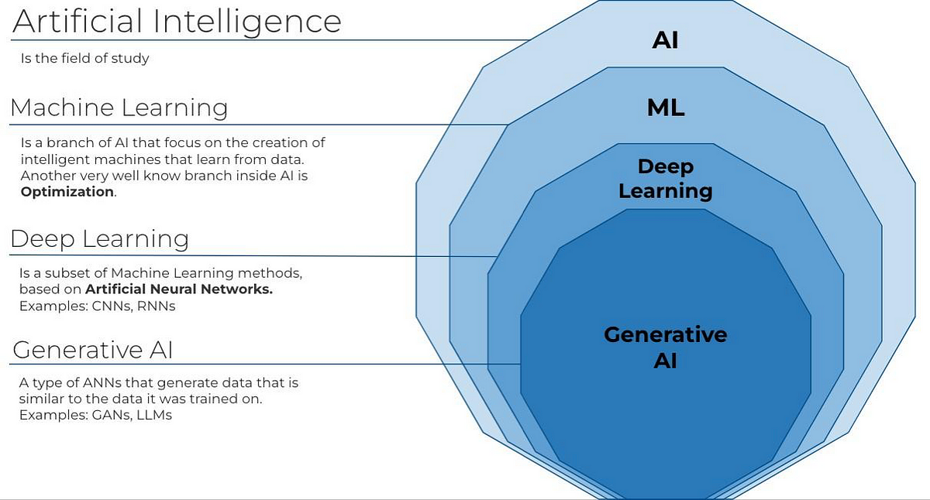
What is AI, ML and Deep Learning?

Slide 3
What is Machine Learning (ML) ?
Machine Learning is the field of study that gives computers the capability to learn without being explicitly programmed. Below are the sub-divisions in Machine Learning:
Supervised Machine Learning
Classification
Regression
Unsupervised Machine Learning
Association Rule Mining
Clustering
Reinforcement Learning
Solving Puzzles or Mazes
Text Summarization

Slide 4
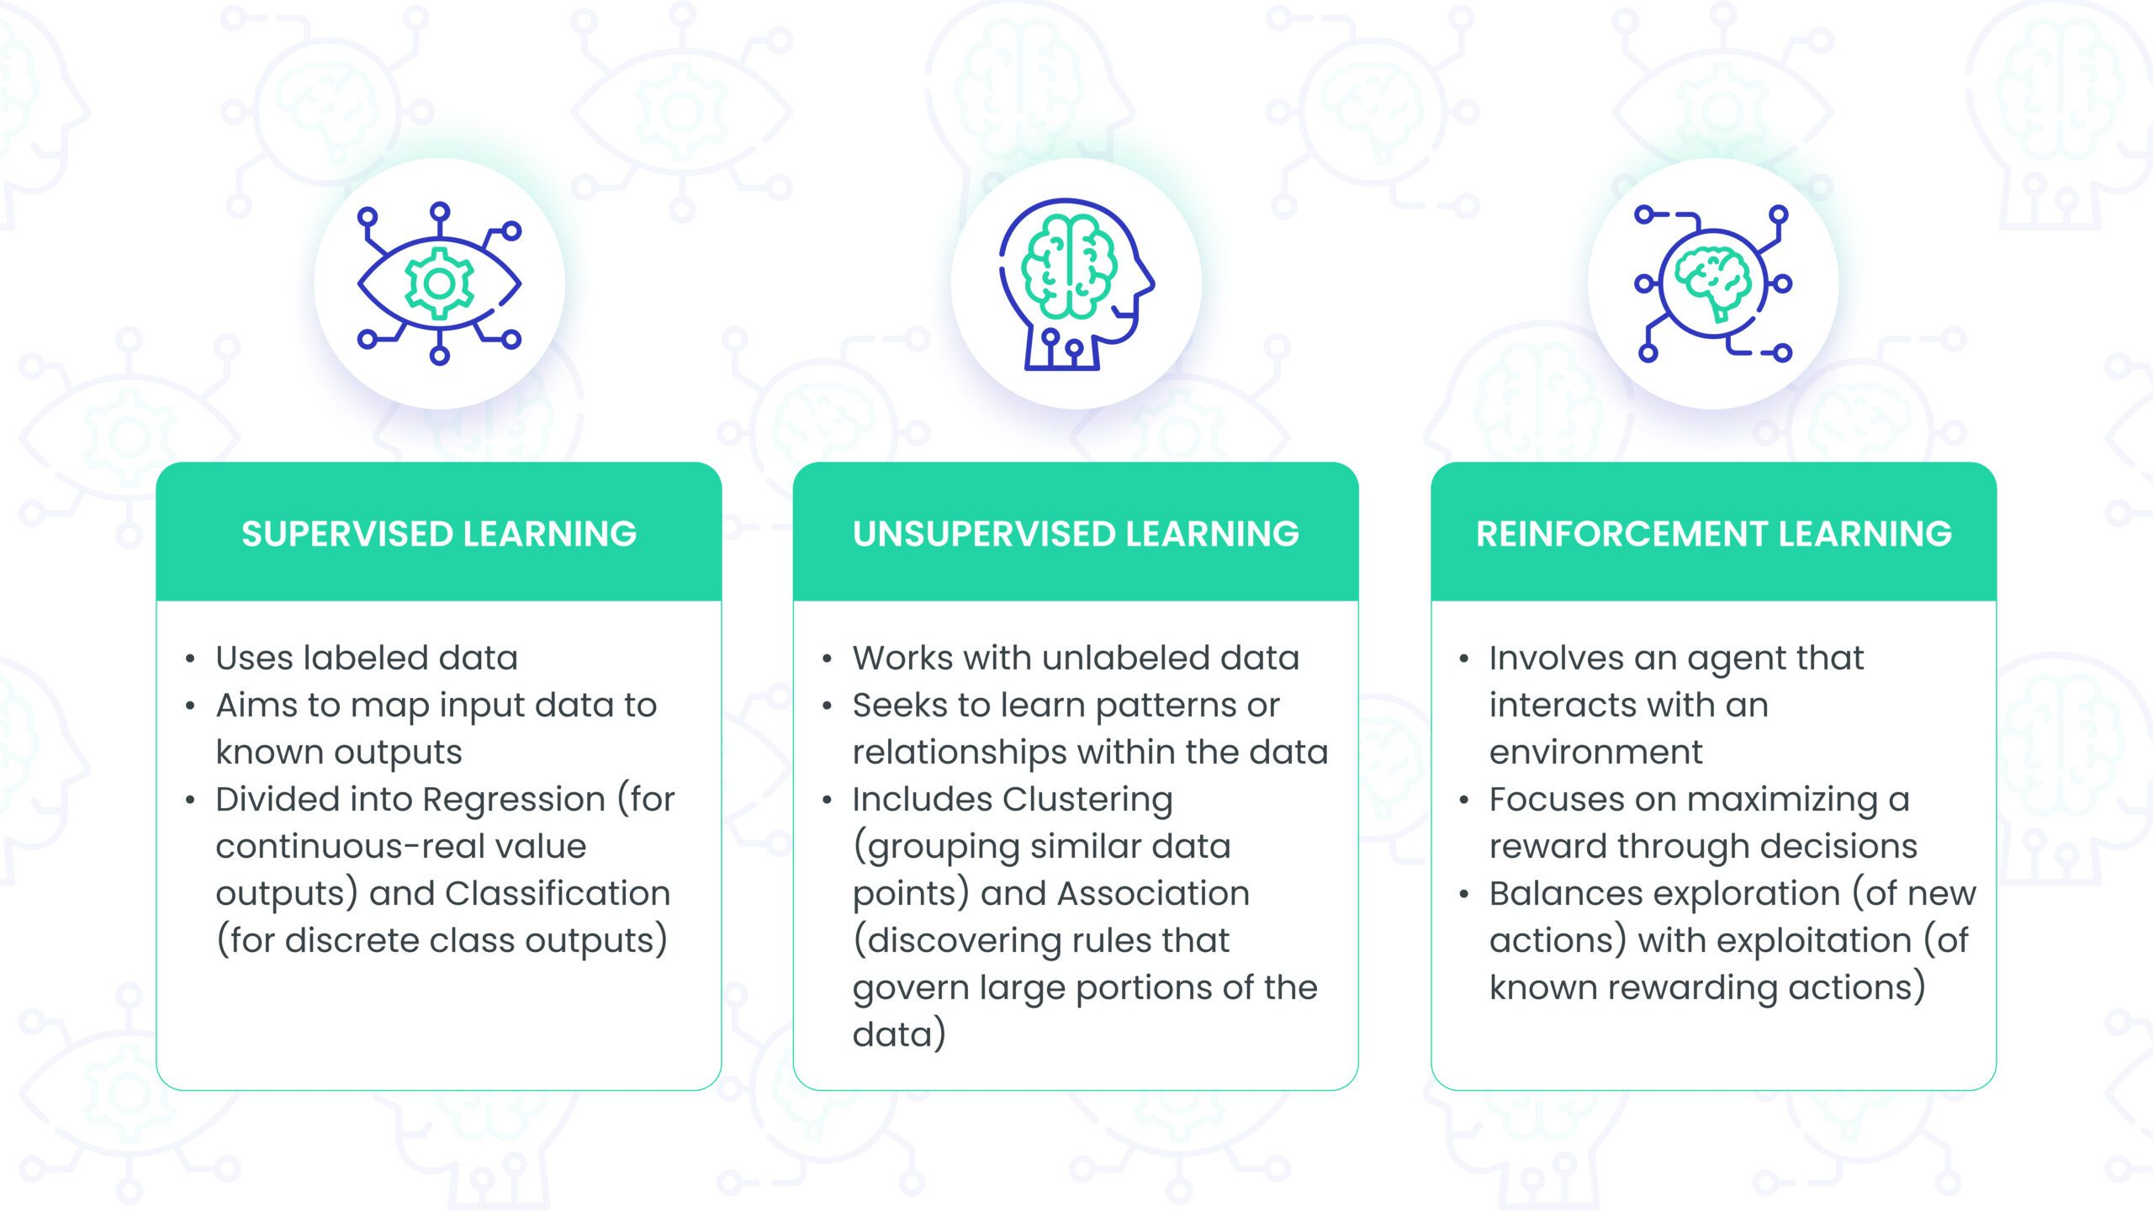
Supervised (VS) Unsupervised (VS) Reinforcement Learning

Slide 5
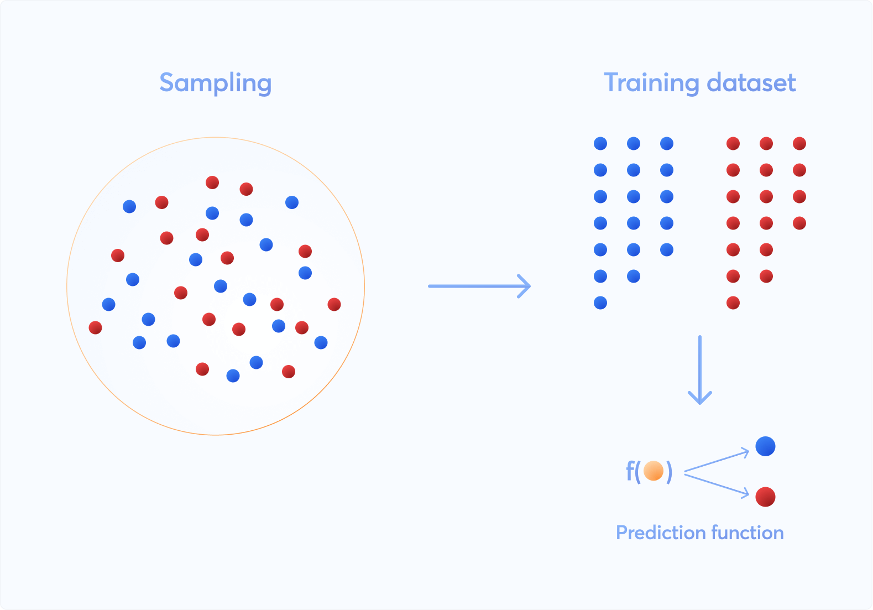
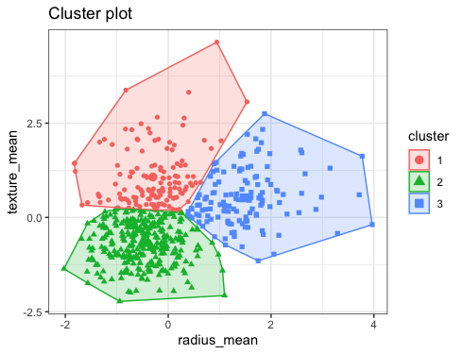
A Use-Case
Consider a Scenario of Box Office Prediction of movie.
The following variables would define the Box Office Collections:
Prediction of Box office collections is a Supervised Scenario
Hero, Director, Cast, Past history of Hero/Director, Avg Collections, Genre etc
2. Understanding/Grouping Movies/Actors based on these attributes could be a Clustering Model which is Unsupervised Scenario

Slide 6
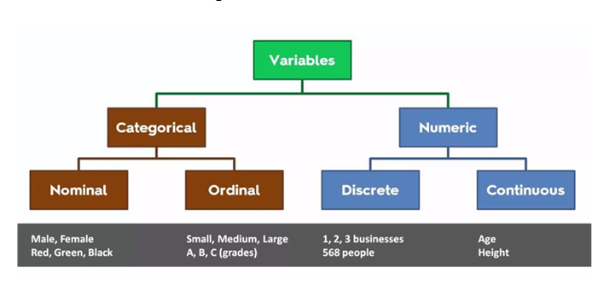
DATA
Numerical and Categorical
Numerical
Discrete
Continuous
Categorical
Nominal
Ordinal

Slide 7
Data normalization
Numerical Variables:
Standardization: Scaling the values in the range of [-3,3] based on mean and standard deviation of the variable. Converts any distribution to Normal Distribution (Which is Ideal Distribution for ML)
Normalization: Also called as Min-Max Scaler, Scales the values to [0,1] based on the minimum and maximum value of the variable.
Categorical Variables:
One Hot Encoding: An encoding where each class is treated independent and is treated as a vector/variable
Label Encoding: An encoding where each class is represented with a unique integer

Slide 8
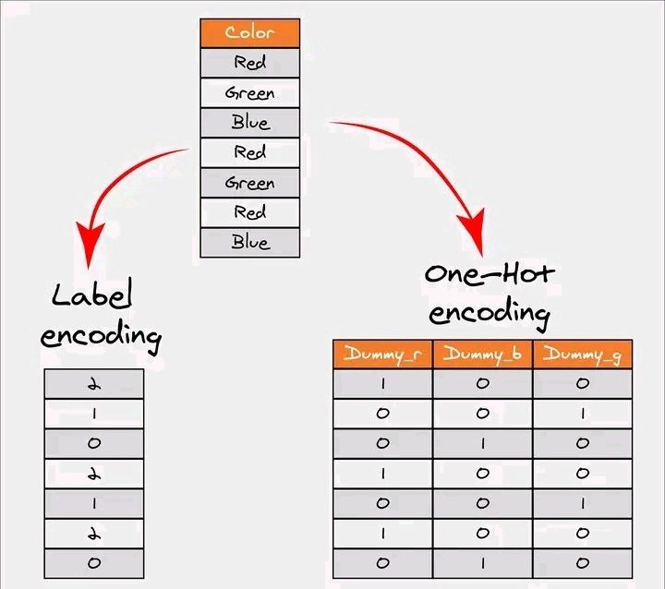
Data normalization

Slide 9
Supervised Machine Learning
Classification:
A Task where a model learns to classify a record to any of the trained target classes
Models like Decision Tree Classifier, Logistic Regression, SVM Classifier, KNN and Ensemble models are used for Classification Tasks
Some Metrics to measure the performance of the Classification include Accuracy, Precision, Recall, F1 Score.
Regression:
A Task where a model learns to predict a continuous numerical value of a record
Models like Linear Regression, Decision Tree Regressor, SVM Regressor, KNN and Ensemble models are used for Regression Tasks
Some Metrics to measure the performance of the Regression include MSE( Mean Squared Error),
RMSE(Root Mean Squared Error), MAPE(Mean Absolute Percentage Error), MAE(Mean Absolute Error) etc.

Slide 10
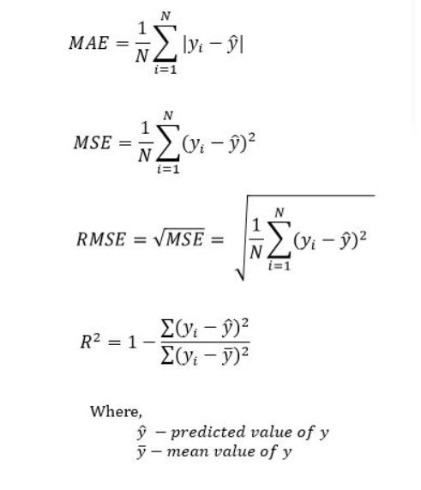
Regression Metrics

Slide 11
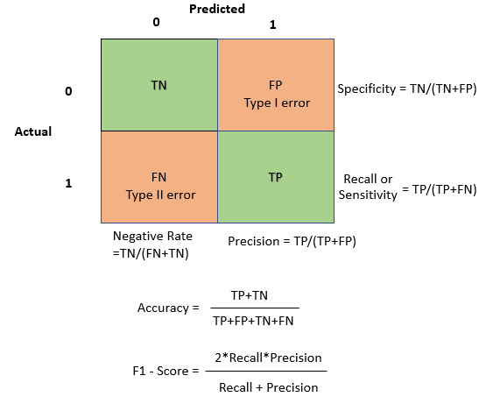
Classification metrics

Slide 12
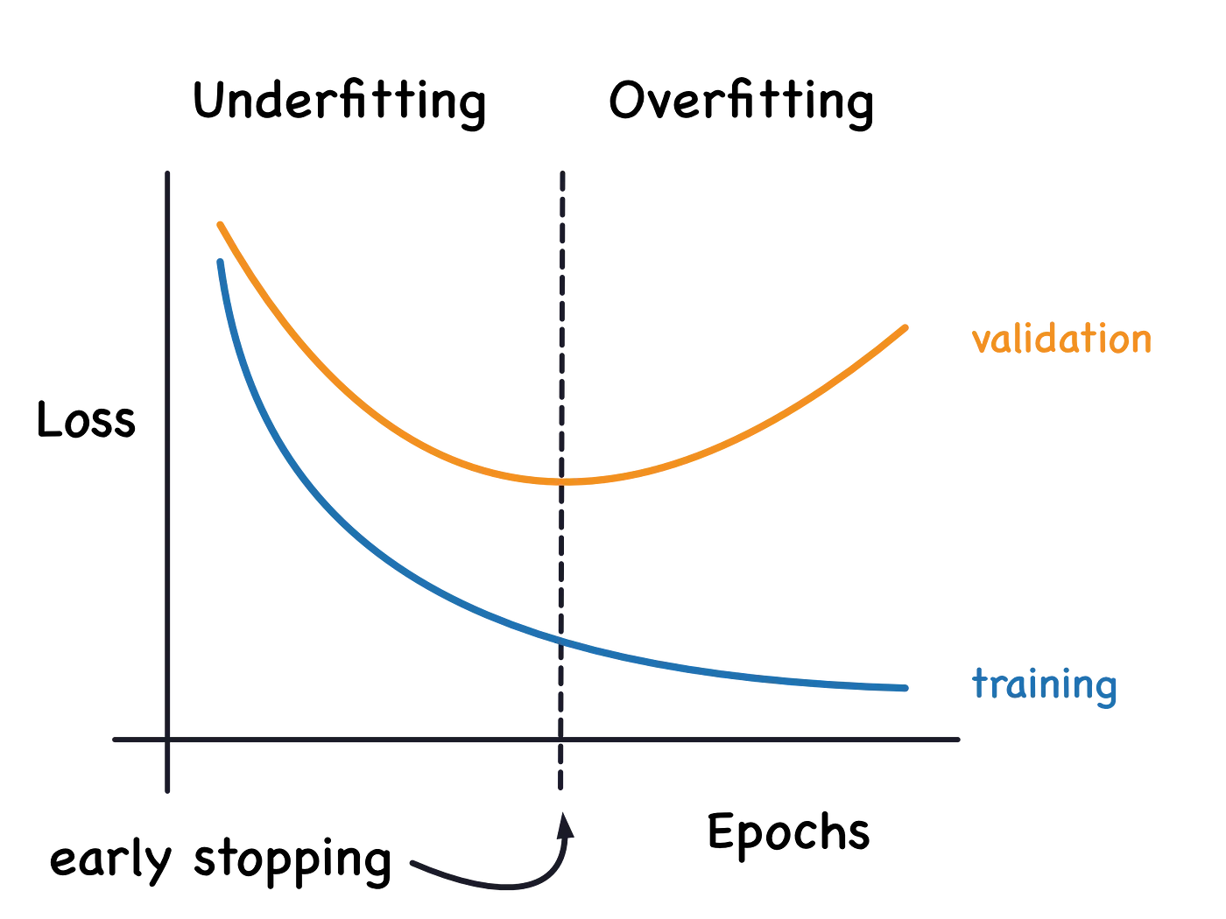
Overfitting & Regularization
Underfitting : The tendency of model that doesn’t learn the patterns in the data (Weakly learns). This can be identified by the performance of the model on training and test data.
Overfitting : The tendency of the model that memorizes the pattern in which data set is dispersed in multi-dimensional space rather than understanding and thereby being specific to that pattern/data . This can be identified by the performance of the model on training and test data

Slide 13
Why and How to detect Overfitting
WHY : You only get accurate predictions if the machine learning model generalizes to all types of data within its domain. Overfitting occurs when the model cannot generalize and fits too closely to the training dataset instead. Overfitting happens due to several reasons, such as:
The training data size is too small and does not contain enough data samples to accurately represent all possible input data values.
The training data contains large amounts of irrelevant information, called noisy data.
The model trains for too long on a single sample set of data.
The model complexity is high, so it learns the noise within the training data.
HOW : The best method to detect overfit models is by testing the machine learning models on more data with with comprehensive representation of possible input data values and types.
Typically, part of the training data is used as test data to check for overfitting. A high error rate in the testing data indicates overfitting. One method of testing for overfitting is given below.

Slide 14
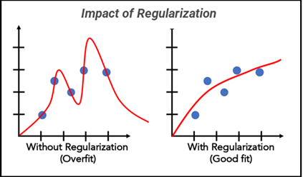
Overfitting & Regularization
Regularization – Solution for Overfitting
Regularization is a technique used in machine learning to prevent overfitting and improve the generalization performance of models. In essence, regularization adds a penalty term to the loss function, discouraging the model from learning overly complex patterns that may not generalize well to unseen data. This helps create simpler, more robust models.

Slide 15
Other approaches to prevent overfitting
Early stopping : Early stopping pauses the training phase before the machine learning model learns the noise in the data. However, getting the timing right is important; else the model will still not give accurate results.
Ensembling : Ensembling combines predictions from several separate machine learning algorithms. Some models are called weak learners because their results are often inaccurate. Ensemble methods combine all the weak learners to get more accurate results. They use multiple models to analyze sample data and pick the most accurate outcomes. The two main ensemble methods are bagging and boosting. Boosting trains different machine learning models one after another to get the final result, while bagging trains them in parallel.
Data augmentation : Data augmentation is a machine learning technique that changes the sample data slightly every time the model processes it. You can do this by changing the input data in small ways. When done in moderation, data augmentation makes the training sets appear unique to the model and prevents the model from learning their characteristics. For example, applying transformations such as translation, flipping, and rotation to input images.

Slide 16

Grid Search Cross validation

Slide 17
Some best cases to use the models
Decision Trees :
Best for Classification cases with minimal processing, easy prototype.
This model is easy for interpretation and visualization
SVM :
Best for high dimensional data (sparse data)
Best for very less data.
The most balanced model (chances of overfitting are very minimal)
Random Forest/ Ensemble :
A powerful, high-accuracy model
An Ensemble model, a collection of models.
A robust model that works well without heavy tuning

Slide 18
Neural Networks
Neural Networks are a subset of machine learning inspired by the structure and functioning of the human brain. They are composed of interconnected layers of nodes (also called neurons) designed to recognize patterns and solve complex computational problems.
Key Components:
Input Layer: Receives input data (e.g., images, text, or numerical data).Passes data to subsequent layers for processing.
Hidden Layers: Consist of multiple layers of neurons. Perform computations using weights, biases, and activation functions. Extract and transform features from the input.
Output Layer: Produces the final result (e.g., class label, numerical value).Number of neurons corresponds to the desired output dimensions.

Slide 19
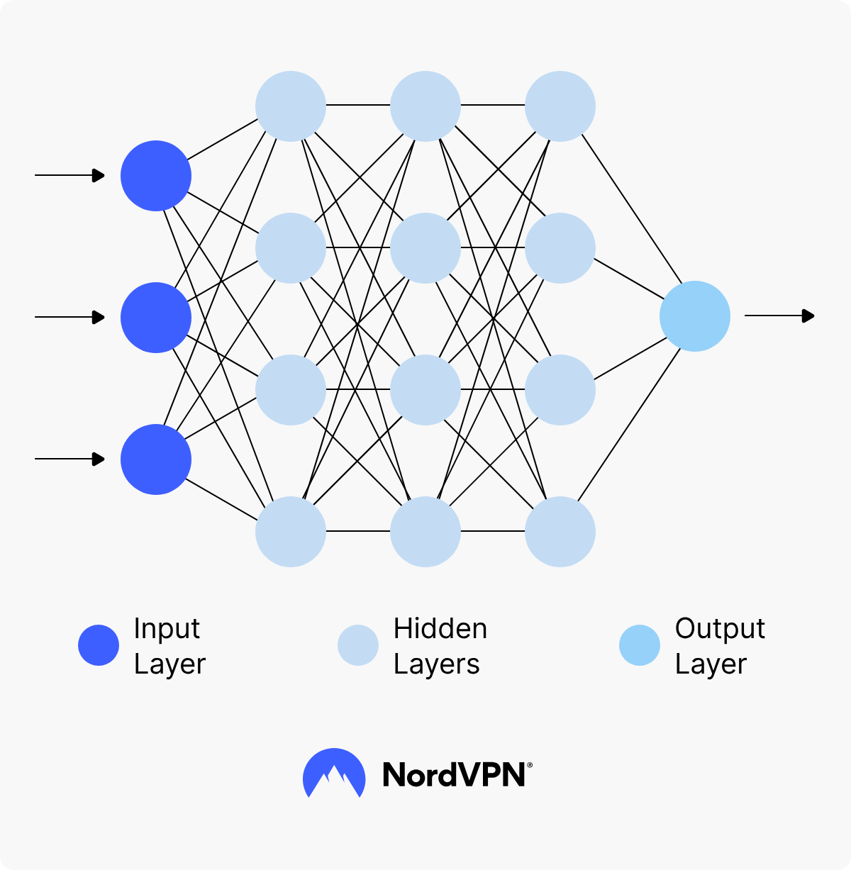
Neural Networks

Slide 20
What are Neural Networks Used for?
Image recognition : Platforms like Facebook employ neural networks for tasks such as photo tagging. By analyzing millions of images, these networks can identify and tag individuals in photos with remarkable accuracy.
Speech recognition : Virtual assistants like Siri and Alexa utilize neural networks to understand and process voice commands. By training on vast datasets of human speech from various languages, accents, and dialects, they can comprehend and respond to user requests in real-time.
Medical diagnosis : In the healthcare sector, neural networks are revolutionizing diagnostics. By analyzing medical images, they can detect anomalies, tumors, or diseases, often with greater accuracy than human experts. This is especially valuable in early disease detection, potentially saving lives.
Financial forecasting : Neural networks analyze vast amounts of financial data, from stock prices to global economic indicators, to forecast market movements and help investors make informed decisions.

Slide 21
Reference links
Machine Learning, AI and Deep Learning : https://medium.com/edureka/machine-learning-tutorial-f2883412fba1
Data Normalization : https://medium.com/p/d3505a0d1892
Machine Learning in detail : https://medium.com/p/9dd66f80e75c
Neural Networks : https://medium.com/@techwithjulles/introduction-to-neural-networks-and-trading-basics-of-neural-networks-f5b538678485

